Slide 1





PROJECT REPORT
Adversarial Attacks on YOLOv9e for Aerial Object Detection
Investigating Vulnerabilities in Aerial Object Detection through White-box, Black-box, and Patch-based Attacks
https://github.com/brij-desaii/Adverserial_Attacks_On_DOTA
December 3rd, 2025
Madhav Sood
Yukta Rajapur
Brij Desai
Shlok Agrawal

Slide 2
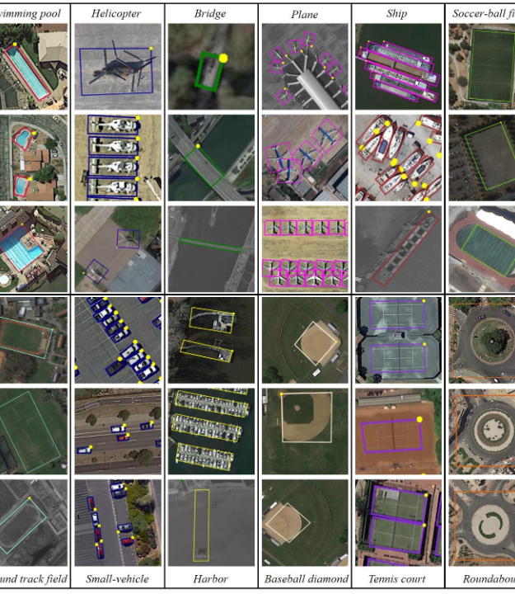
Project Overview
The Model: YOLOv9e (Extended). Pretrained model used. https://github.com/davidgeorgewilliams/Aerial-YOLO-DOTA
The Dataset: DOTA (Dataset for Object Detection in Aerial Images). Challenges include massive image sizes (4000x4000) and high object density. DOTA-v2.0
The Goal: To evaluate vulnerability to imperceptible perturbations (FGSM, One-Pixel) and physical-world threats (Patches).

Slide 3




HIGHLIGHTS
We subjected the YOLOv9e model (trained on DOTA aerial imagery) to three distinct categories of adversarial attacks. All of these experiments were done with 374 validation images.
Whitebox Attack (FGSM): Highly effective Caused a massive 20% drop in mAP, proving the model is brittle to gradient-aligned noise.
-20.5%
~0%
FGSM MAP DROP
1-PX ATTACK DROP
Patch Attack: Moderately effective. Our custom RobustDPatch (white-box) reduced mAP by ~10%, outperforming the black-box hill-climbing approach.
-10.0%
-7.9%
ROBUSTDPATCH DROP
BLACK-BOX PATCH DROP
Pixel Attack (Black-box): Ineffective. Perturbations failed to significantly degrade performance, showing robustness to sparse noise.

Slide 4
PART I
White-box FGSM Attack
Exploiting Gradient Sensitivity for Maximum Damage

Slide 5

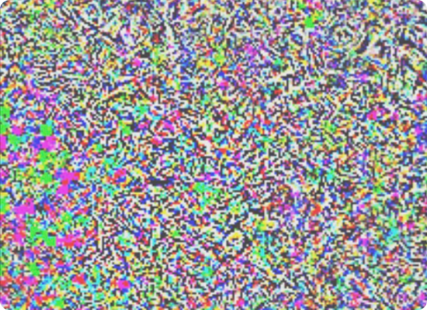

FAST GRADIENT SIGN METHOD (FGSM)
The Concept
FGSM is a "single-step" attack that assumes access to the model's gradients (White-box). Instead of minimizing loss, we maximize it.
We calculate the gradient of the loss function with respect to the input image. This tells us exactly which direction to change each pixel to confuse the model.

Slide 6


FGSM METHODOLOGY
Targeting YOLOv9e Components
In YOLOv9e, the loss function J is a composite of three critical components. Our attack leverages gradients from all three:
Mathematical Formulation
•
Box Regression Loss: Disrupts the precise localization of bounding boxes (DFL).
Where x is the clean image, y is the ground truth label, theta represents model parameters, and epsilon iis the perturbation magnitude.
•
Objectness Loss: Targets the model's confidence that an object exists in a specific grid cell.
•
Classification Loss: Confuses the class prediction (e.g., Plane vs. Ship).

Slide 7
IMPLEMENTATION PIPELINE
Step-by-Step Execution
# 1. Setup
model.train() # Enable gradient tracking
img.requires_grad = True
# 2. Forward Pass
preds = model(img)
loss, loss_items = compute_loss(preds, targets)
# 3. Backward Pass
loss.backward()
# 4. Generate Perturbation
data_grad = img.grad.data
perturbed_img = fgsm_attack(img, epsilon, data_grad)
# 5. Clamp & Save
final_adv_img = torch.clamp(perturbed_img, 0, 1)
save_image(final_adv_img, "adv_val_set/")
1.
Load Model: Initialize pretrained YOLOv9e.
2.
Preprocessing: Normalize input image and enable requires_grad.
3.
Loss Computation: Perform forward pass to compute total loss (Box + Obj + Cls).
4.
Gradient Extraction: Backpropagate to find J
5.
Perturbation: Apply the sign of the gradient scaled by epsilon.
6.
Validation: The resulting adversarial dataset mirrors the clean validation set structure for direct comparison.

Slide 8
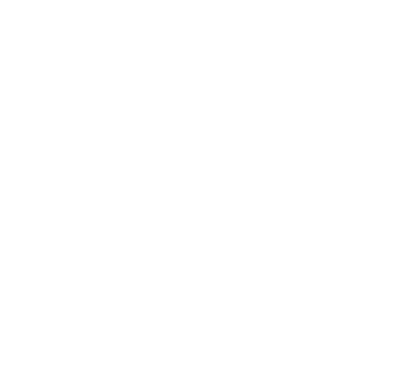
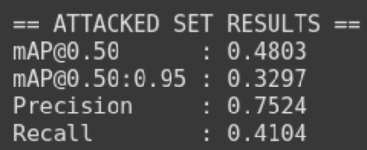
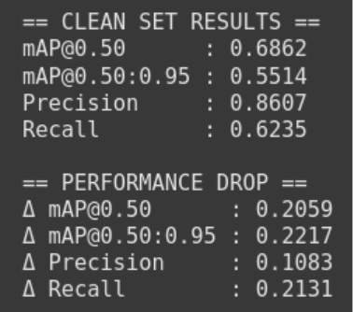

FGSM IMPACT ANALYSIS
Decent Failure
The white-box attack was considerably effective. The 21.3% drop in Recall indicates that the attack successfully "hid" many objects from the detector.
Performance Drop (mAP@0.50)
-20.59%

Slide 9
PART II
Black-box Pixel Attacks
Testing Robustness Against Sparse Perturbations

Slide 10
METHOD 1: ONE-PIXEL RANDOM SEARCH
Brute Force Simplicity
for _ in range(30):
x, y = get_random_coords()
# Test variations
candidates = [
invert_pixel(img, x, y),
set_pixel(img, x, y, (0,0,0)),
set_pixel(img, x, y, (255,255,255)),
set_pixel_random(img, x, y)
]
for cand in candidates:
score = query_model(cand)
if score < best_score:
best_img = cand
Goal: Find the single most disruptive pixel (location + color) to lower the model's confidence.
Algorithm:
•
Loop 30 attempts per image.
•
Pick a random coordinate $(x, y)$.
•
Test 4 variations: Invert color, Black (0,0,0), White (255,255,255), Random RGB.
•
Query the model (Black-box) and record the confidence score.
•
Keep the perturbation that minimizes the score.

Slide 11
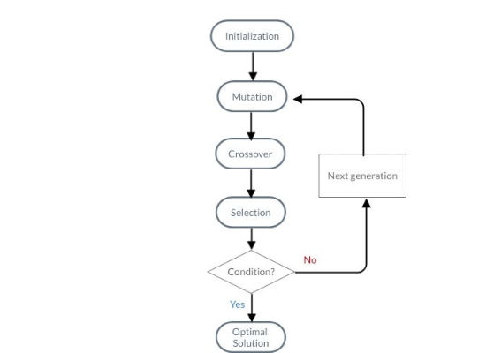
METHOD 2: ONE-PIXEL DIFFERENTIAL EVOLUTION
Intelligent Search
Instead of random guessing, we use Differential Evolution (DE), an evolutionary algorithm, to optimize the 5-dimensional attack vector:
Vector = (x, y, R, G, B)
Process:
1.
Initialize population of 10 random pixels.
2.
Evolve for 25 generations.
3.
Mutate/Crossover successful candidates to find the "fittest" (most damaging) pixel.

Slide 12

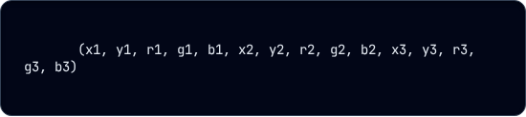
METHOD 3: THREE-PIXEL DE
Escalating the Attack
We expanded the search space to modify 3 pixels simultaneously. This theoretically increases the attack surface significantly.
Search Complexity
The Vector (15 Dimensions):
Finding the optimal 3 pixels in a 4000x4000 image is a massive optimization problem.
15-Dim Search Space
DE helps navigate this better than random search, but the sparsity is still a major hurdle for YOLOv9.
Constraints:
•
Sample Size: Due to high compute cost (minutes per image), we evaluated on a random 5% subset (18 images).
•
Goal: Minimize sum of detection confidence scores.

Slide 13
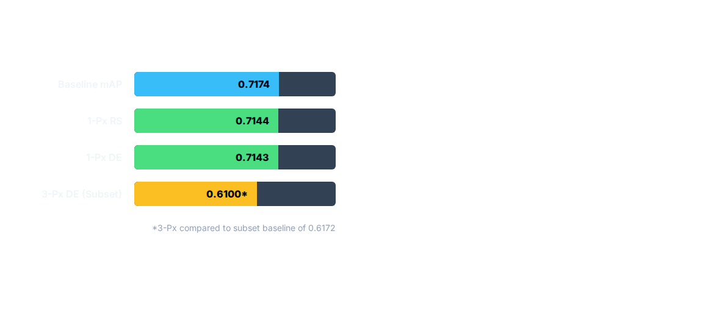
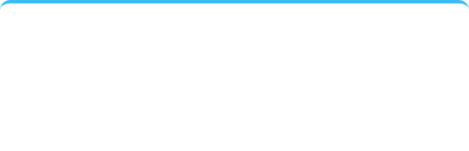
RESULTS: ROBUSTNESS TO SPARSE NOISE
Analysis: Failure to Launch
The pixel attacks failed to dent the model's performance. The drop was statistically insignificant (< 0.5%).
Precision-Recall Anomaly
Precision dropped (~4%), but Recall increased (~1.5%). The random noise acted as a distractor, causing false positives, but accidentally helped the model find some edge-case objects.

Slide 14
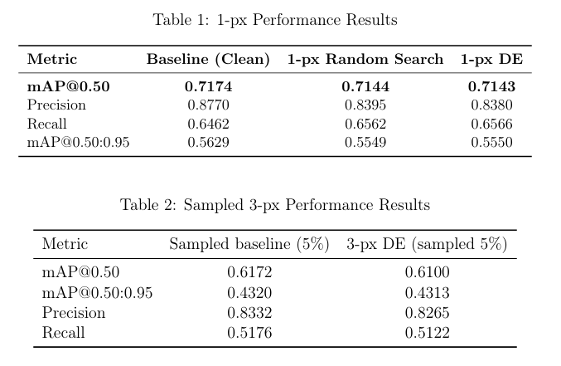
RESULTS: ROBUSTNESS TO SPARSE NOISE

Slide 15
PART III
Patch-based Attacks
From Black-box Heuristics to White-box Gradients

Slide 16
ATTACK 1: BLACK-BOX UNIVERSAL PATCH
def optimize_patch():
patch = initialize_random_patch()
best_score = float('inf')
for iteration in range(N):
# 1. Mutate: "Paint" rectangles or add noise
candidate = mutate(patch)
# 2. Evaluate with EoT (Expectation over Transforms)
current_score = 0
for img in validation_batch:
# Apply patch with random scale/rotation
patched_img = apply_eot(img, candidate)
preds = yolo_predict(patched_img)
current_score += sum(preds.confidences)
# 3. Hill Climbing Selection
if current_score < best_score:
patch = candidate
best_score = current_score
Hill Climbing POC
This is a query-based Proof-of-Concept (POC). We don't use gradients. We simply "mutate" the patch and keep the version that lowers the model's confidence sum.
Limitations:
•
Prone to getting stuck in local optima.
•
Computationally inefficient (requires many inference calls).
•
Acts as a "distractor" rather than a targeted suppressor.

Slide 17

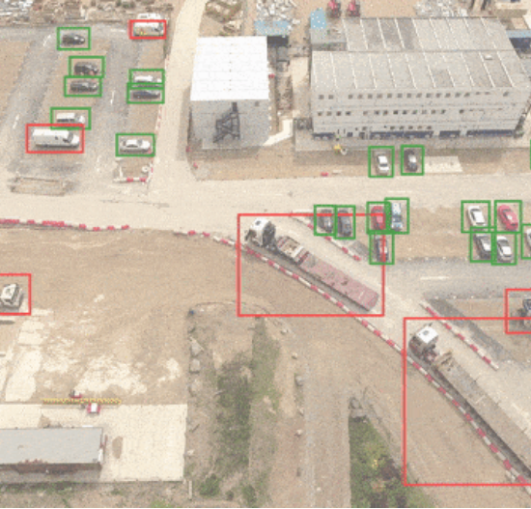
TRAINING WITH EOT
Expectation over Transformations (EoT)
A static patch is weak. If the object moves or rotates, the attack fails. To fix this, we train the patch using EoT.
During every training step:
•
Apply the patch to the image with random Location (x, y).
•
Apply random Scale
•
Apply random Rotation.
•
Apply random Opacity.
The optimizer learns a patch pattern that is robust to all these physical variations.

Slide 18
ATTACK 2: ROBUST DPATCH ATTACK
The Goal
Generate a single, universal patch that suppresses object detection across the entire dataset. This requires access to the model's gradients to optimize the patch pixels directly.
The Challenge
Ultralytics YOLOv9 implementation is designed for inference, not adversarial attacks.
•
No Gradient Access: The standard API applies Non-Max Suppression (NMS), which is non-differentiable and breaks the backward pass.
•
Input Mismatch: ART (Adversarial Robustness Toolbox) expects NCHW float tensors; YOLO expects NHWC uint8.

Slide 19
SOLUTION: CUSTOM WRAPPER CLASS
To bridge YOLOv9 and ART, we implemented YoloV9ARTDetector. This class acts as a wrapper, exposing the necessary internal mechanics of YOLO to the ART optimizer.
class YoloV9ARTDetector(ObjectDetector):
def __init__(self, yolo_model):
# Extract the underlying PyTorch module
self.model = yolo_model.model
# Freeze parameters (we optimize the patch, not the model)
for param in self.model.parameters():
param.requires_grad = False
# Configure ART metadata
super().__init__(
clip_values=(0, 255),
channels_first=True
)

Slide 20
WRAPPER: PREDICT METHOD
def predict(self, x, batch_size=1, **kwargs):
# 1. Input Transformation
# ART gives NCHW float -> YOLO wants NHWC uint8
x_formatted = convert_to_yolo_format(x)
# 2. Standard Inference (With NMS)
# We use the standard API here for evaluation
results = self.yolo_obj.predict(x_formatted, verbose=False)
# 3. Parse Results for ART
art_preds = []
for res in results:
prediction = {
'boxes': res.boxes.xyxy.cpu().numpy(),
'labels': res.boxes.cls.cpu().numpy(),
'scores': res.boxes.conf.cpu().numpy()
}
art_preds.append(prediction)
return art_preds
Bridging the Gap
The predict method handles the format conversion and result parsing.
Critically, this method is used for evaluation. It returns the final, post-processed bounding boxes that a user would see.
Since it includes NMS, it is not used for gradient calculation.

Slide 21
CRUCIAL: LOSS GRADIENT METHOD
Exposing the Gradients
def loss_gradient(self, x, y=None, **kwargs):
# 1. Enable Gradients on Input
x_tensor = torch.tensor(x).to(device)
x_tensor.requires_grad = True
# 2. Switch to Train Mode (Bypass NMS)
self.model.train()
# 3. Forward Pass (Raw Outputs)
preds = self.model(x_tensor)
# 4. Compute Adversarial Loss
# Target: Minimize mean objectness score
loss = torch.mean(preds['objectness'])
# 5. Backward Pass
loss.backward()
return x_tensor.grad.cpu().numpy()
This is the core of the attack. We bypass the NMS and access the raw logic outputs.
1.
Mode Switch: Set model to train() mode. This disables NMS and returns raw tensors.
2.
Adversarial Loss: We define loss as the Mean Objectness across all grid cells.
3.
Optimization Goal: Minimize this objectness. This forces the model to believe "nothing is here."

Slide 22
Training Recipe
The 4-Step Optimization Loop
1. Initialization:
The algorithm starts by creating a "Patch Tensor." This is a square of pixels (RGB) initialized with random noise.
2. Expectation over Transformation:
In every single iteration of the training loop, the algorithm applies the patch to a batch of images. However, it does not just paste it; it applies random physical distortions to simulate real-world conditions.
3. Forward Pass & Loss Calculation:
The transformed images are fed into the YOLOv9 model (in training mode to bypass NMS). The algorithm then calculates the Loss.
4. Backward Pass (The Learning)
Using backpropagation (loss.backward()), the algorithm calculates the gradient of the loss with respect to the pixels of the patch.
Update: The optimizer uses these gradients to adjust the patch pixels in the opposite direction, making the patch slightly better at hiding the object

Slide 23
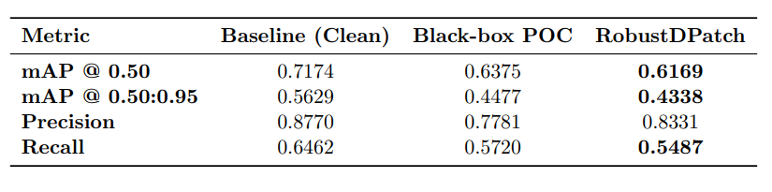
PATCH ATTACK RESULTS

Slide 24


CONCLUSION
Vulnerability Profile
Our comprehensive analysis reveals the security posture of YOLOv9e:
•
Resilient: The model is highly robust to sparse, random noise (Pixel attacks). You cannot break it by changing a few dots.
•
Vulnerable: The model crumbles under gradient-aligned perturbations (FGSM). Deep feature hierarchies propagate these errors effectively.
•
Compromised: Patch attacks are a viable real-world threat. A single printed sticker could theoretically blind the model to aerial targets.

